Slide 1
IPA (International Phonetic Alphabet)

Slide 2
The vowel map…

Slide 3
The vowel map…

Slide 4
The vowel map…
i
u
ε
o
ɑ

Slide 5
Today, more new vowel sounds
/ e / = late, eight, great
/ Ə / = a dog, above
/ oi / = toy, oil, toilet
/ ɑu / = ouch, shout, loud
/ ɑi / = like, night

Slide 6
Additional things …
/ : / = [longer]
/ ɾ / = butter,
/ (…) / = [very soft]

Slide 7
The vowel map…
i
u
ɪ
Ʊ
ε
Λ
o
æ
ɑ

Slide 8
Let’s practice ☺
/ rɪvr / = ______
river
/ mæʧ / = _______
match
/ mΛðr / = ________
mother
/ ʃƱ:d / = ________
should

Slide 9
Let’s practice ☺
/ ʃo: mi / = _________
Show me.
/ ʃu:z / = ______
shoes
/ bΛɾr / = _______
butter
/ fɪŋgr / = ______
finger

Slide 10
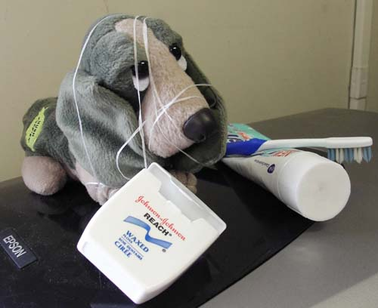
We’d be happy to entertain any questions at this time!
(sorry if we’ve tied you in knots)

