Slide 1
IPA (International Phonetic Alphabet)
Notes:
Background = “essential”

Slide 2
Again, the Japanese vowels
ア = / ɑ /
イ = / i /
ウ = / u /
エ = / ε /
オ = / o /

Slide 3
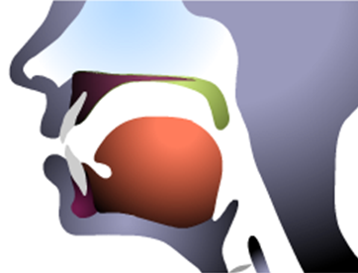
The Vowel Map

Slide 4
The Vowel Map

Slide 5
The Vowel Map
i
u
ε
o
ɑ

Slide 6
Today, some new vowel sounds
/ ɪ / = hɪt, rɪver, fɪsh
/ æ / = hat, cash, fast
/ Λ / = up, lunch, butter
/ Ʊ / = foot, should, push, Elwood ☺
Λ = ‘lambda’
Ʊ = ‘upsilon’

Slide 7
The vowel map…
High, back vowel
High, front, lax vowel
i
u
ɪ
Ʊ
ε
Λ
o
Low, front vowel
æ
ɑ
Mid, stressed vowel

Slide 8
Let’s practice ☺
/ rɪvɚ / = ______
river
/ mæʧ / = _______
match
/ mΛðɚ / = ________
mother
/ ʃƱ:d / = ________
should

Slide 9
Let’s practice ☺
/ ʃo:mi / = _________
Show me.
/ ʃu:z / = ______
shoes
/ bΛɾɚ / = _______
butter
/ fɪŋgɚ / = ______
finger

Slide 10
A moment ago we had
/ bΛɾɚ / = _______
butter
What is that / ɾ / symbol?
It is a / t / or /r/ with no aspiration (that ‘puff’ of air).

Slide 11
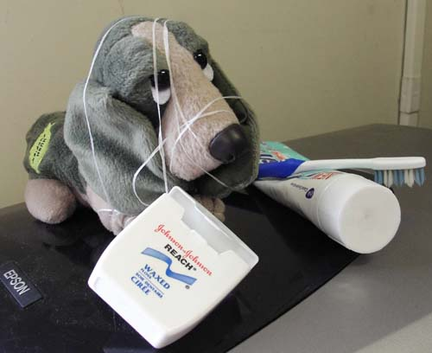
I’d be happy to entertain any questions at this time!
(sorry if I’ve tied you in knots)

