Slide 1
The Vietnam War
Ohtakeguchi Kaori
Saito Kana
November 25, 2011
Understanding Other Cultures

Slide 2
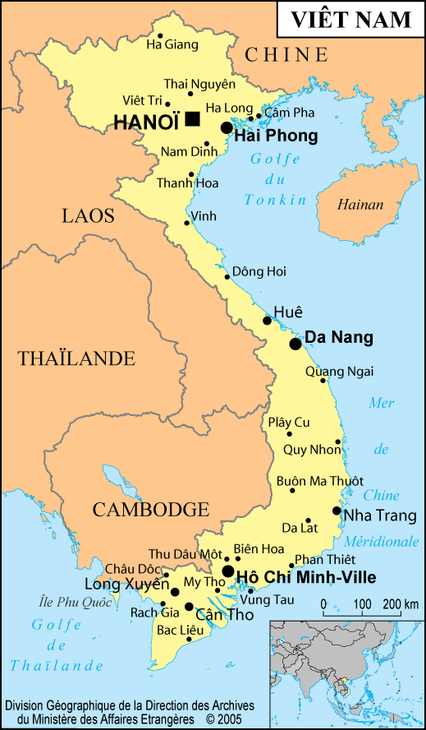
Map

Slide 3
Background of the War
When… the beginning of 1960s-1975.4.30
Where… Vietnam
Why… to unify North Vietnam and
South Vietnam
Result … North Vietnam won and unified
Victims … more than 2,000,000

Slide 4
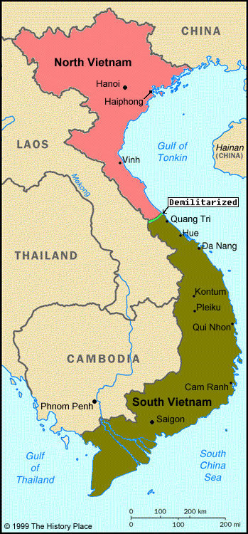
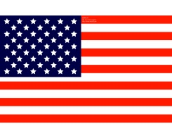
North Vietnam
The Soviet Union China
South Vietnam
The US

Slide 5
【Contrast of North and South】
 | North Vietnam | South Vietnam
leader | Hồ Chí Minh | Ngô Ðình Diệm
allies | The Soviet Union, China | The US
policy | communism | capitalism
flag

Slide 6
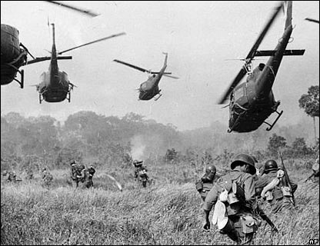
Why was the US involved?
In order to deter any expansion of communism by the Soviet Union
Military expenditure… $150,000,000,000
Soldiers… 540,000 per year (at the peak)
Characteristic… defoliation

Slide 7
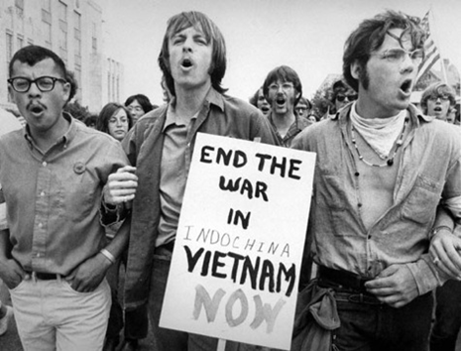
1960s in the US
Counterculture of Youth
Segregation of Races
Wars
Existing
Moral Sense
Segregation by Gender
Segregation by Color
Notes:
Anti-war Protests

Slide 8
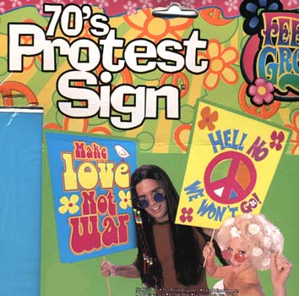
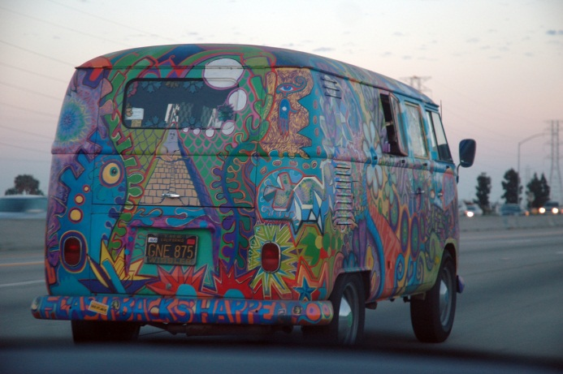
Hippies
“Love and Peace”
Brightly colored clothes, Long hair,
Rock music, Illegal drugs …

Slide 9
The End of the War
US Stopped Bombing North Vietnam
Paris Accords
1975 Saigon → Ho Chi Minh
Notes:
What happened?
Which leads to …

Slide 10
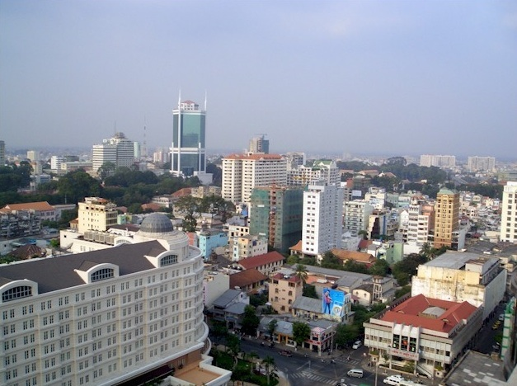
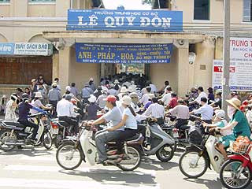
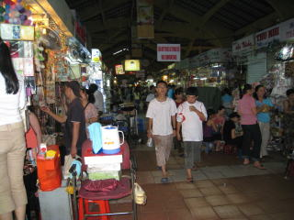
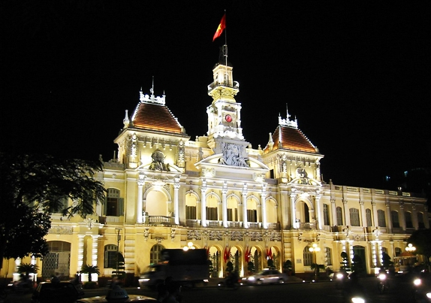
Vietnam Now

Slide 11
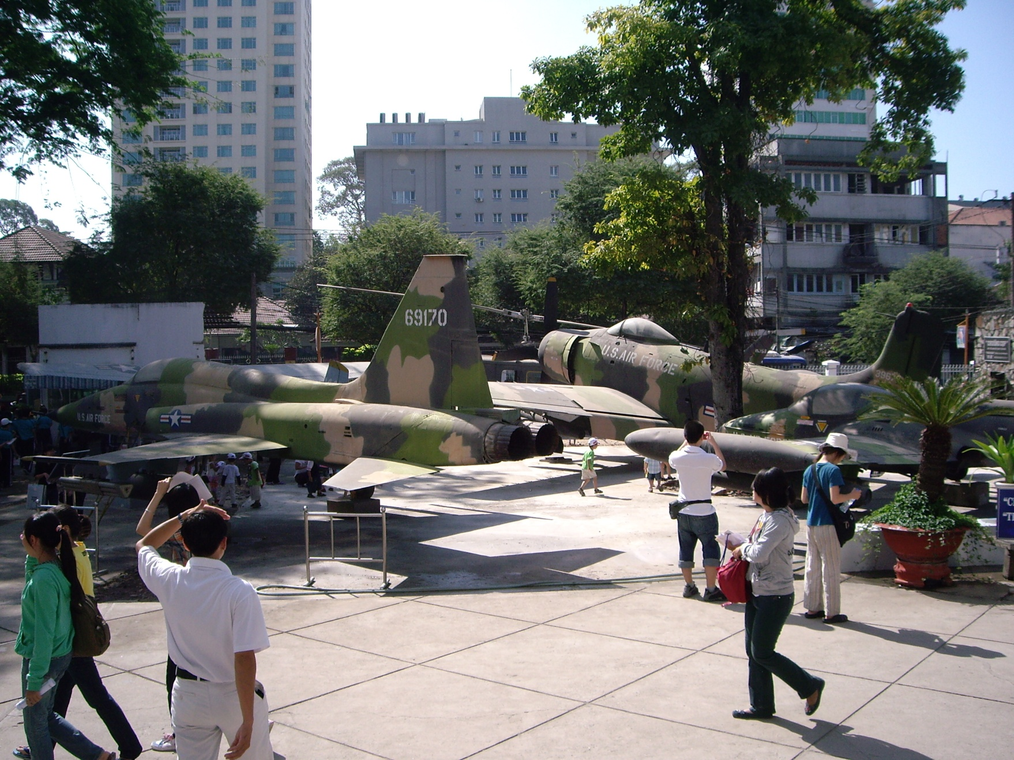
Vietnam Now

Slide 12
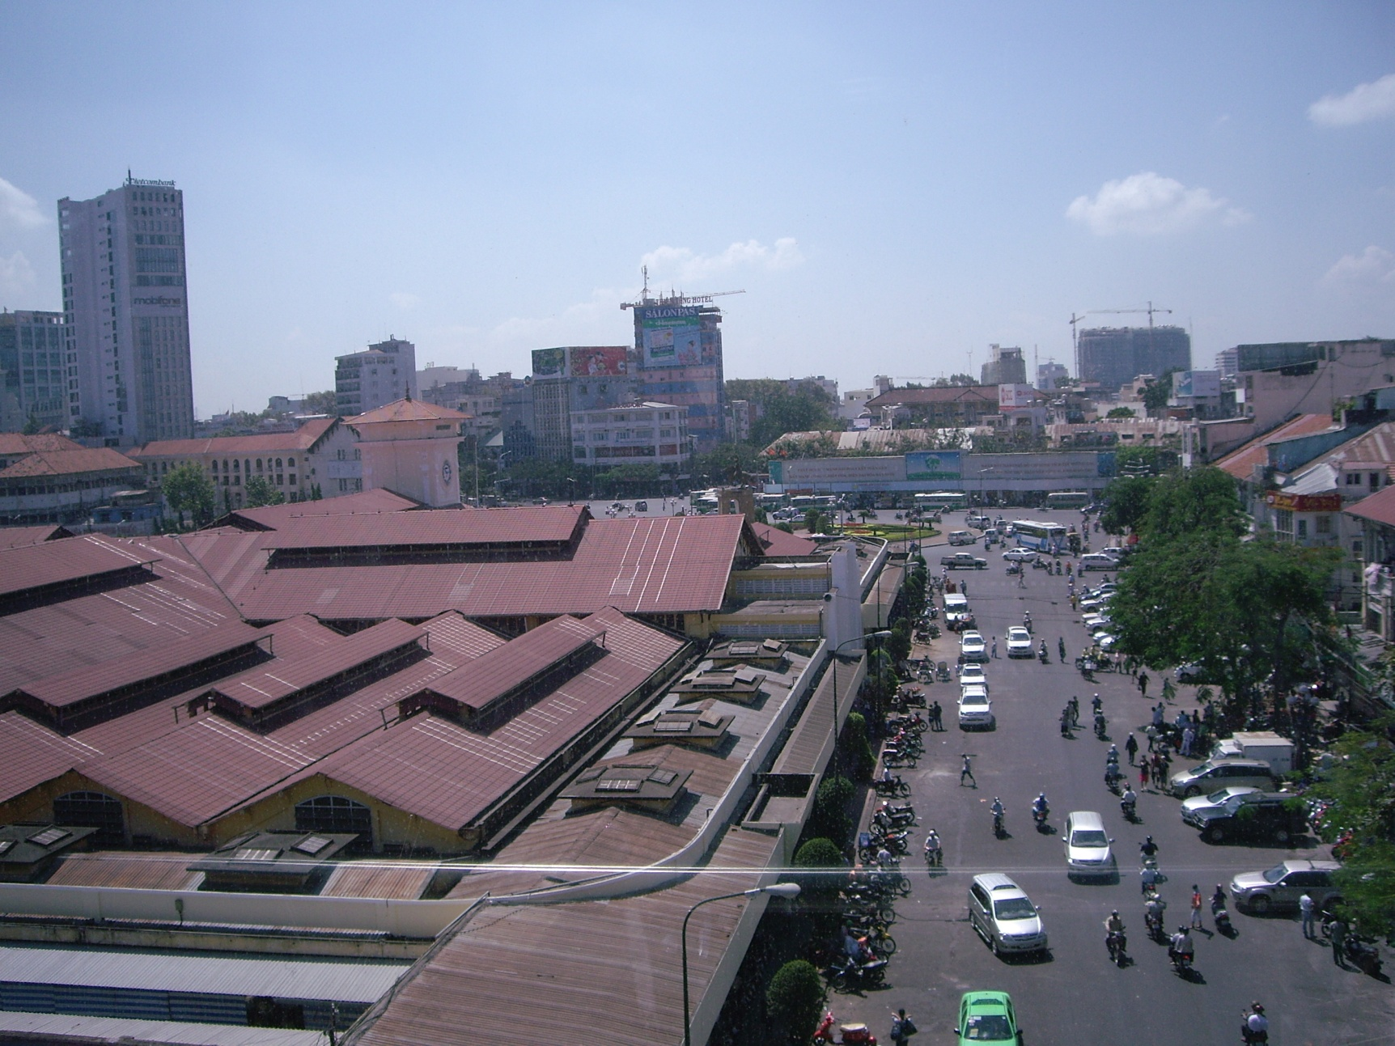
Vietnam Now

Slide 13
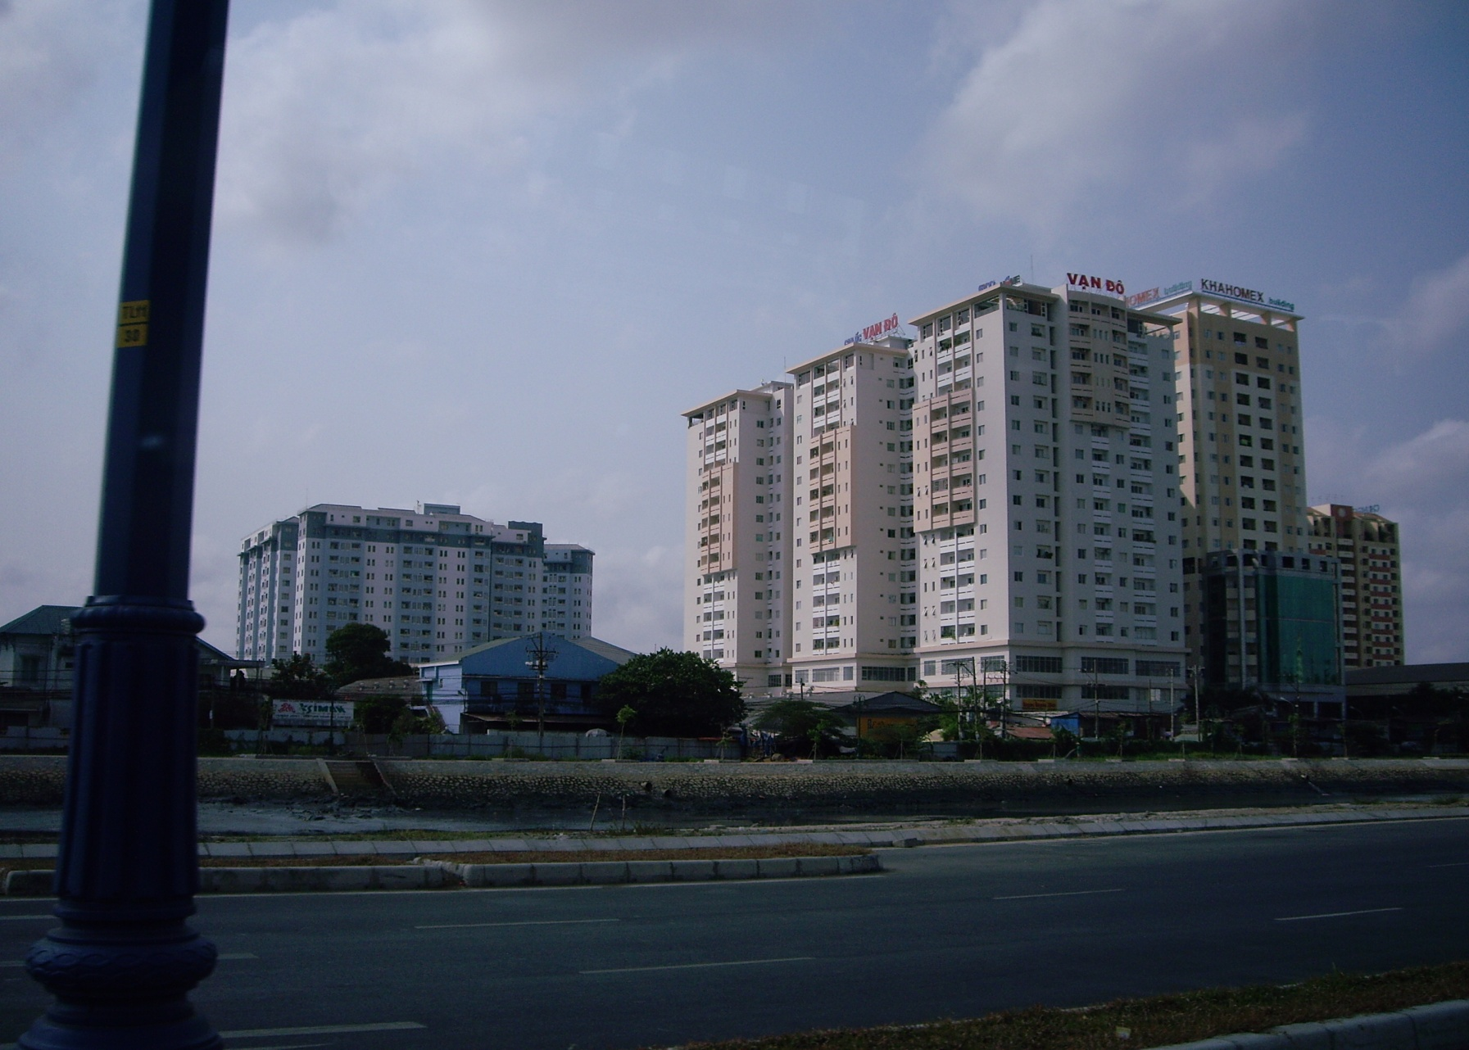
Vietnam Now

Slide 14
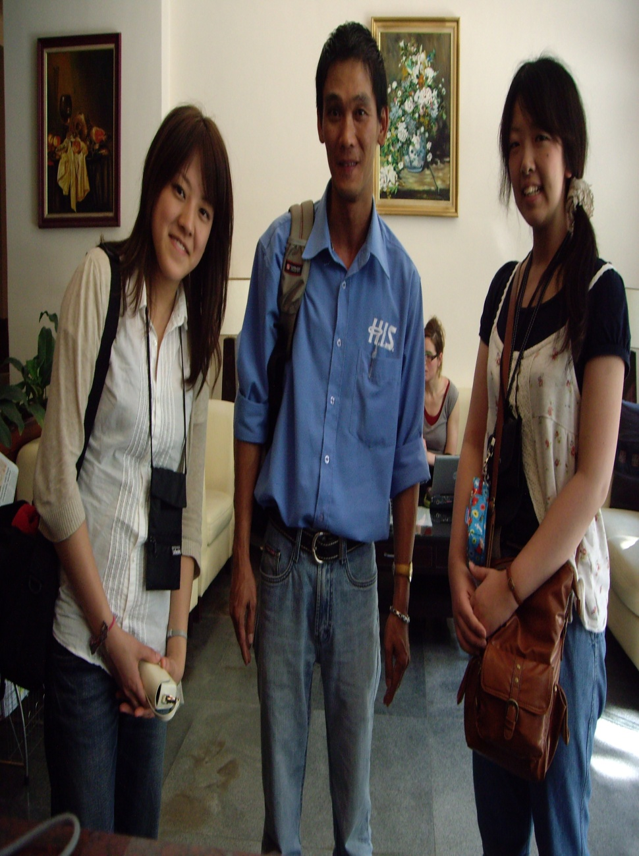
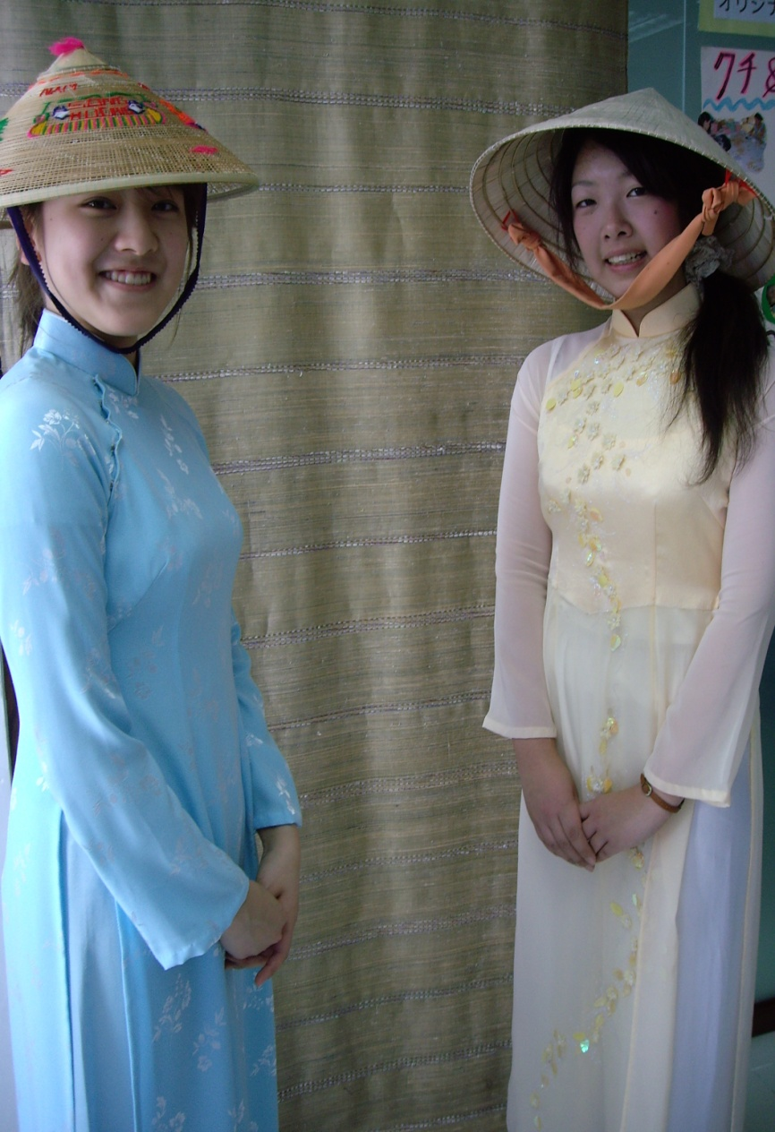
Vietnam for Sightseeing

Slide 15
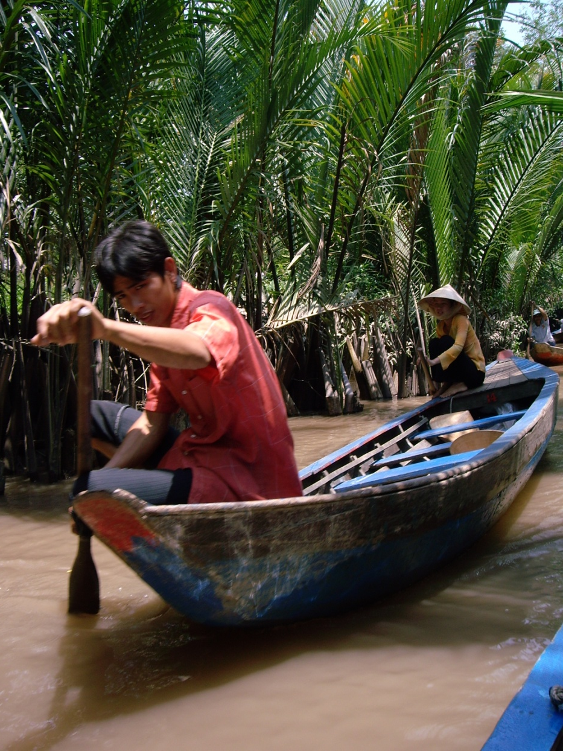
Vietnam for Sightseeing

Slide 16
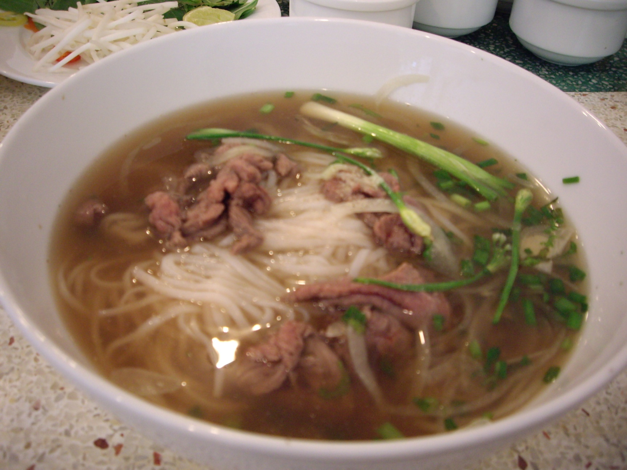
Vietnam for Sightseeing

Slide 17
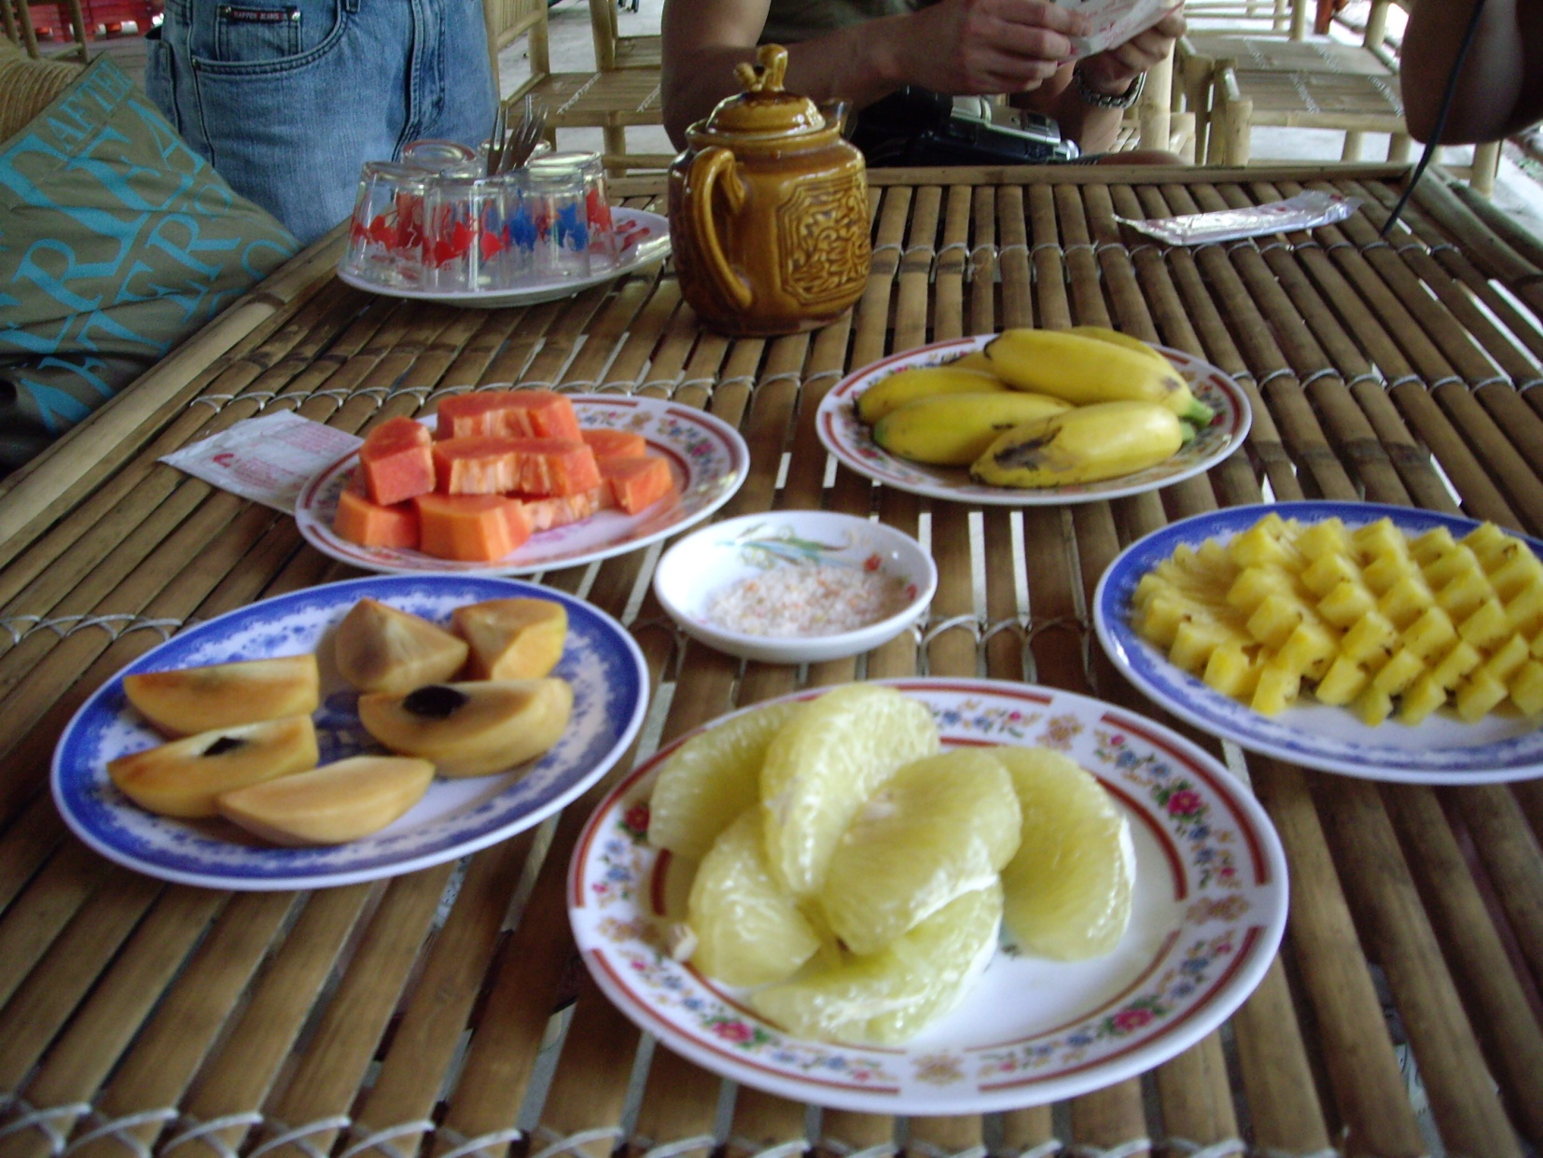
Vietnam for Sightseeing

Slide 18
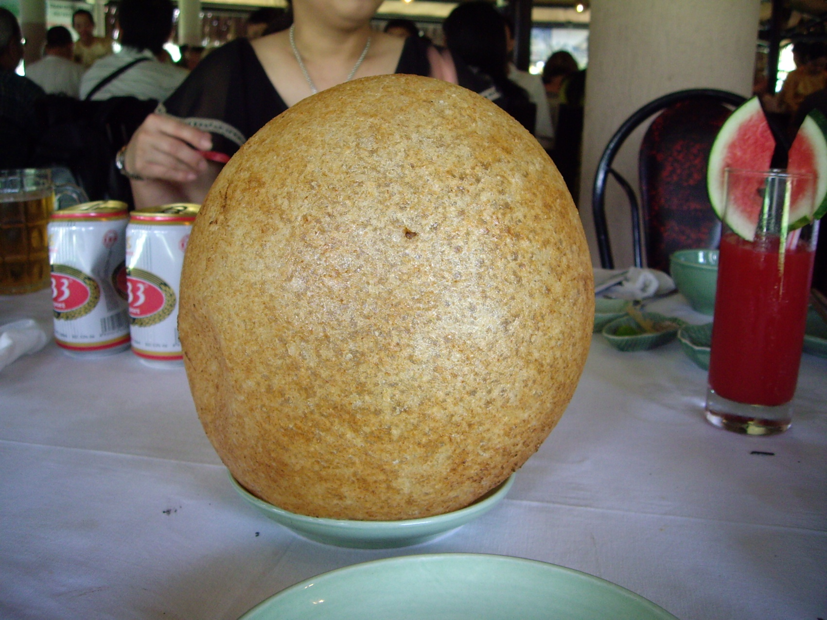
Vietnam for Sightseeing

Slide 19
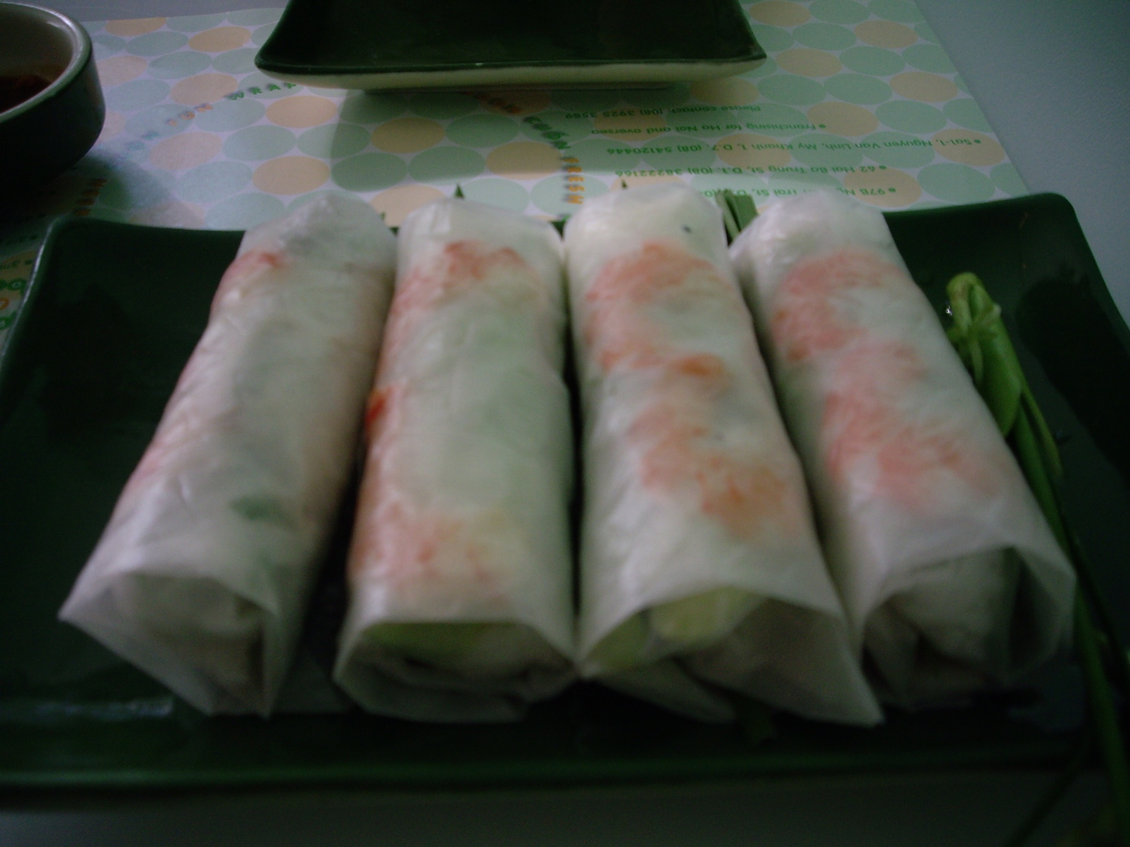
Vietnam for Sightseeing

Slide 20
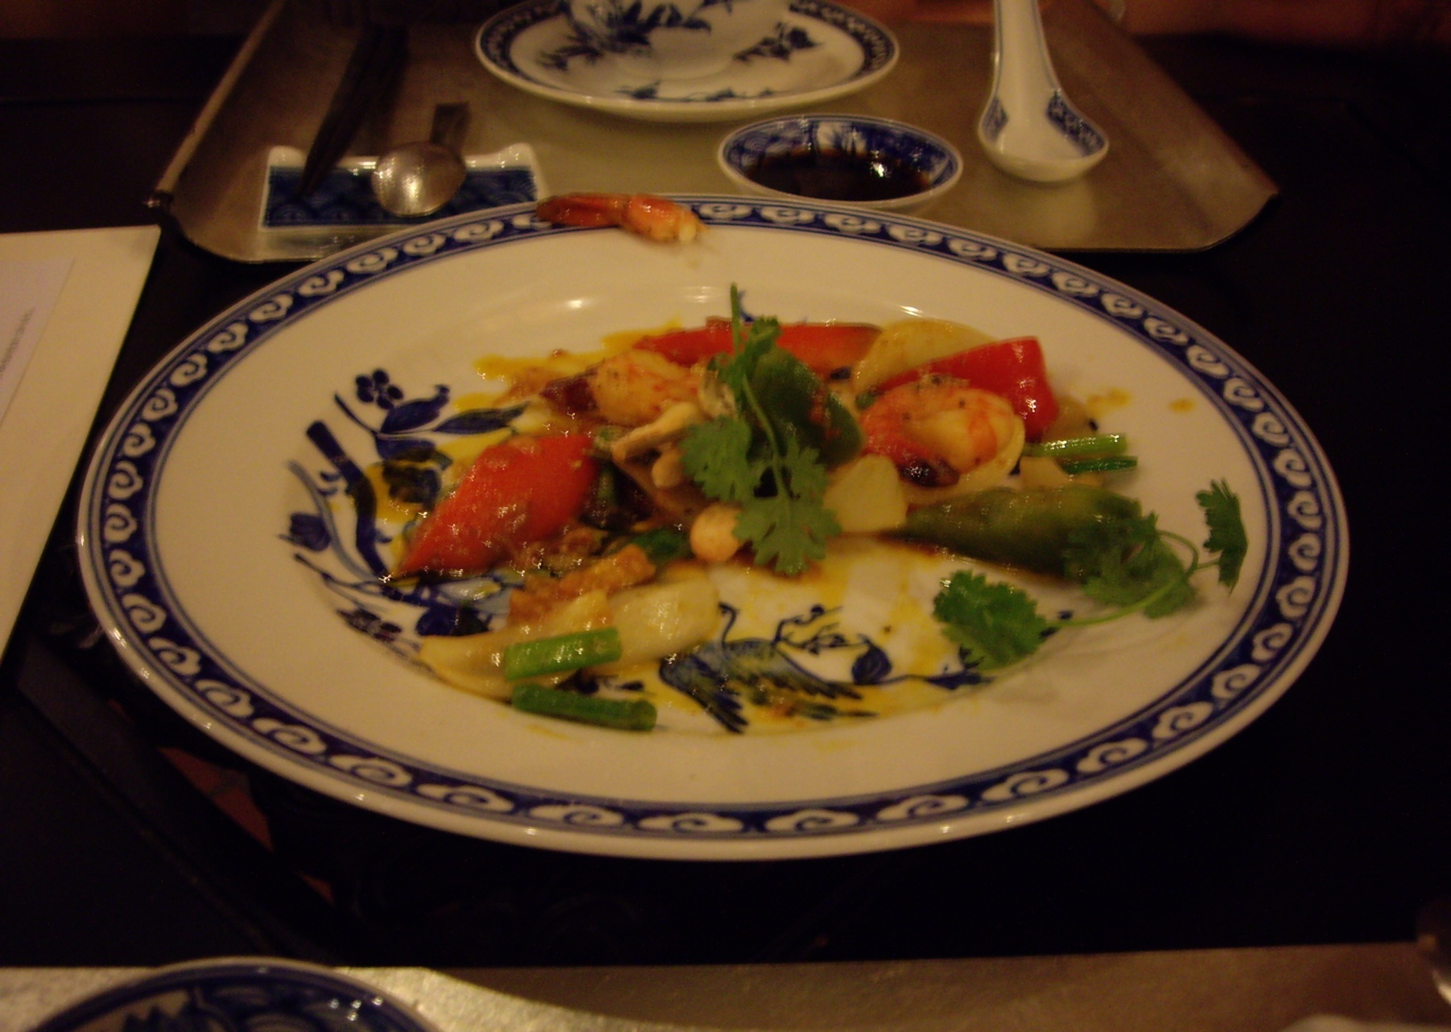
Vietnam for Sightseeing

Slide 21
Thank you for listening!
Do you have any questions?

