Slide 1
The Spread of McDonald’s and Globalization
Yuki Kondo, Shinnosuke Hagiwara, Ryota Matsui, Taiga Kawakami

Slide 2
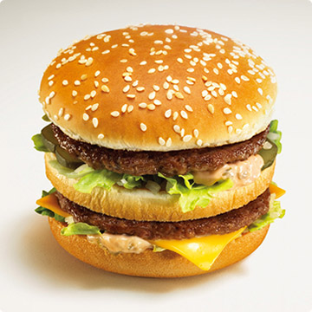
Table of Contents
Introduction – Taiga Kawakami
McDonald’s in Japan – Shinnosuke Hagiwara
McDonald’s in Korea – Yuki Kondo
McDonald’s in India – Ryota Matsui
Conclusion – Taiga Kawakami

Slide 3
What is Globalization?
Oxford English Dictionary Definition
Globalization = Americanization?
U.S. – only superpower
Spread of McDonald’s

Slide 4
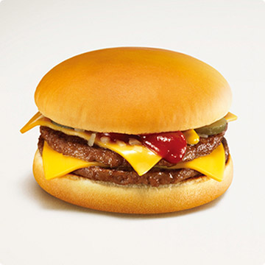
Group Project
Globalization ≠ Homogenization
Group opinion: People transform American culture so that it can coexist with their original culture.
Project: McDonald’s as a specific example

Slide 5
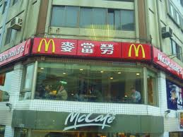
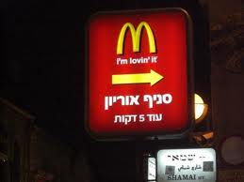
McDonald’s in Japan
201110393
Shinnosuke Hagiwara

Slide 6
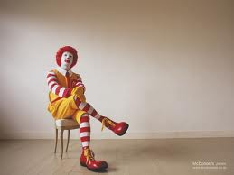
Outline
History of McDonald’s in Japan
Characteristics of McDonald’s in Japan
Conclusion

Slide 7
History of McDonald’s in Japan
1st McDonald’s store opened at Ginza Mitsukoshi in 1971
On December 16th in 1990, the amount sold of McDonald’s was over 1,000,000,000 yen
In 2012, Japan McDonald’s is 40 years old and its slogan is Beyond40, MAKE WOW

Slide 8
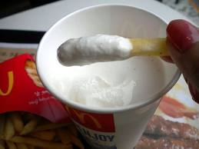
Points
Japan McDonald’s is now the most powerful firm of the food service industry in Japan.
How could this firm be such powerful?
Clues are Here.
Japanization

Slide 9
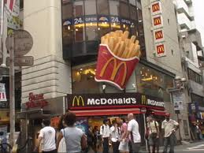
Why Ginza?
The first president of this firm persisted in Opening first McDonald’s in Ginza.
→He believed that Ginza was the center of popularity.
If McDonald’s becomes popular in Ginza, it will be popular in Japan
→People’s impression of McDonald’s has become “McDonald’s is Urban”

Slide 10
McDonald’s→マクドナルド
The pronunciation “McDonald’s” is obviously different from the pronunciation “マクドナルド”
→The first president, Mr.Fujita changed its pronunciation.
He wanted to make rhyme with this pronunciation so that people can feel friendliness to McDonald’s.

Slide 11
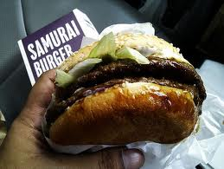
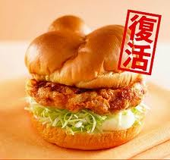
Menu
Teriyaki Burger
Chicken Tatsuta
Ebi Fillet-o

Slide 12
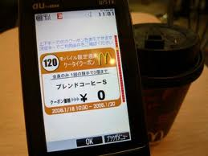
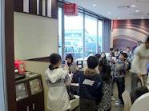
How to sale
Keitai coupon
Nintendo DS campaign

Slide 13
Conclusion
Meat and bread are regularly eaten
Ginza McDonald’s made this company famous
Japan McDonald’s are selling Japanaized products (Size, tastes)
Coupons for cell phone attracts many people
Nintendo DS campaign attracted children

Slide 14
→ McDonald’s uses cultural background really effectively. In Japan, we can call it Japanization.
And this(adapting to each country) is why this company has become one of the most powerful company not only in Japan or America, but also around the world.

Slide 15
McDonald’s in Korea
Yuki Kondo

Slide 16
Outline
History of McDonald’s in Korea
How McDonald’s has succeeded in Korea
Price
Menu
Other characteristics
Conclusion

Slide 17
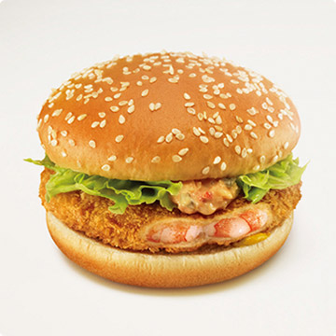
History
Started in 1988, when Seoul Olympic was held
Merger Corporation in Pusan
Focusing on cities → expanded into Northeast
Several years to be accepted
Korean consumers like McDonald’s now

Slide 18
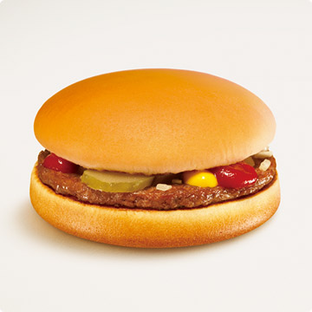
How McDonald’s succeed in Korea
Products for Koreans
Research about Korean consumers
Accepting their opinions
Learning what they want
→ feedback about what they demand

Slide 19
Price
Said to be relatively low or reasonable
→ most of value-sets cost 3000~4200 won
However…
Wages in Korea is a little low
→ Cannot buy Big-Mac-set even if they work for one hour as McDonald’s crew

Slide 20
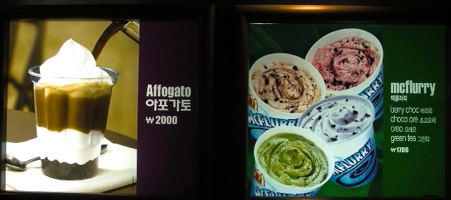
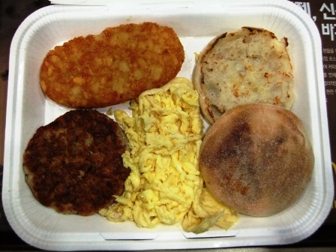
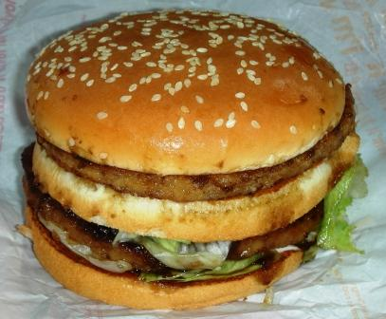
Menu
Bulgogi Burger
Big Breakfast
Affogato (Italian dessert)

Slide 21
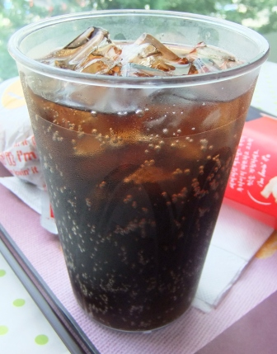
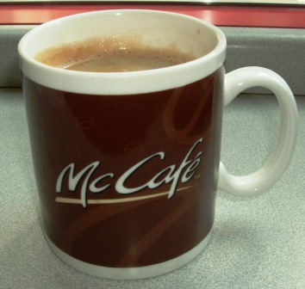
Other characteristics

Slide 22
Conclusion
Efforts to be popular in Korea
Innovation again and again
McDonald’s in Korea must continue to make changes in way of promotion so that they can keep attracting its consumers.

Slide 23
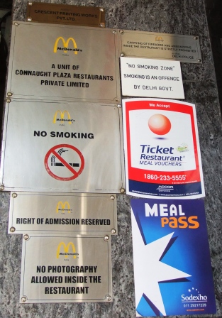
McDonald’s in India
Ryota Matsui

Slide 24
Outline
McDonald’s in India
Characteristics of McDonald’s in India
No beef!
Water?

Slide 25
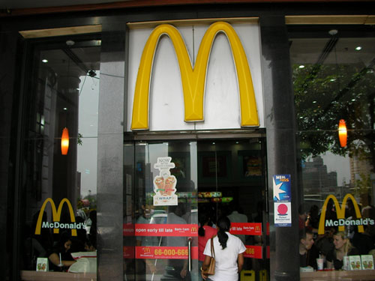
High-class McDonald’s
McDonald’s in delhi has much
tourists and the wealthy.
There are 100 stores in India

Slide 26
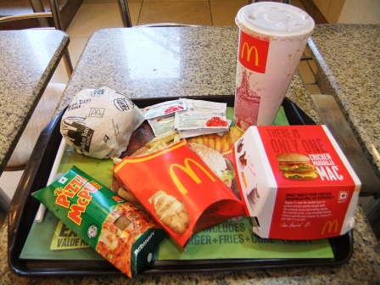
No beef!
In India, McDonald’s does not sell hamburger which includes beef. 80% of people in India are Hinduism, so they can’t eat beef because of religion.
Chicken Maharaja Mac
About 400 yen

Slide 27
water?
only in order to buy water, there are many visitors who visit McDonald's.

Slide 28
Conclusion
World is becoming “borderless”
≠ Homogenization
Culture transforms in the shape that is suited for each country.

Slide 29
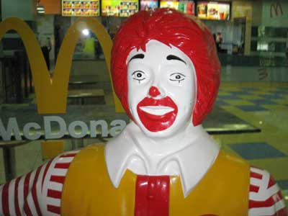
Thank you!!

