Slide 1
IPA (International Phonetic Alphabet)

Slide 2
First, a review…
“phonetic” means … sound
The basic idea is one symbol = one sound
IPA symbols are in slashes / … /

Slide 3
Today, the Japanese vowels
ア = / ɑ /
イ = / i /
ウ = / u /
エ = / ε /
オ = / o /
Note: only the small epsilon (ε) is new.
This ε is the small Greek letter epsilon.

Slide 4
The Vowel Map
We use a simple map of a person’s mouth to show the place of articulation.
First, imagine a person’s head …

Slide 5
The Vowel Map
Now imagine inside the mouth…

Slide 6
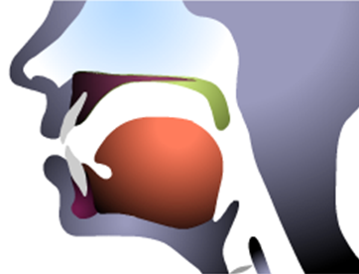
The Vowel Map

Slide 7
The Vowel Map
Now imagine a box…here…

Slide 8
The Vowel Map

Slide 9
The Vowel Map

Slide 10
The Vowel Map
High, front, tense vowel
High, back, rounded vowel
i
u
Mid, back, rounded vowel
Mid, front, unrounded vowel
o
ε
ɑ
Low, back, rounded vowel

Slide 11
The Vowel Map
i
u
ε
o
ɑ

Slide 12
I’d be happy to entertain any questions at this time!
(sorry if I’ve tied you in knots)

